Slide 1
Intro to Linkbots and C-STEM
Getting Started with Linkbot Programing

Slide 2
DISCLAIMER
It is highly recommended that you go through the Intro to Ch presentation before using this.
This presentation assumes a basic knowledge of Ch.
Intro to Ch can be found at: https://docs.google.com/presentation/d/1A5D0RsxduY1pWAKTr6OXinuWdoNYqpwK0j33CLCEV-g/edit?usp=sharing

Slide 3
Types of Linkbots
There are two types of linkbots you will be using: Linkbot-Is and Linkbot-Ls
A Linkbot-I is a linkbot with movable joints on opposite sides, so that when you put your hands on them, it looks like an I.
A Linkbot-L is a linkbot with movable joints on adjacent sides, so that when you put your hands on them, it looks like an L.

Slide 4
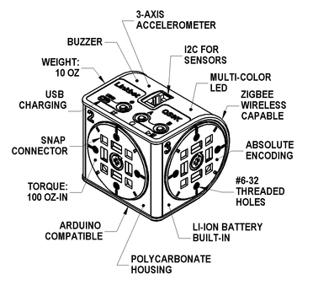
The features of a Linkbot

Slide 5
The Battery of a Linkbot
It is powered by an internal, rechargeable lithium-ion battery that can drive motors for over 3 hours with typical use. Charging is done through the USB port with a cable and takes about 4 hours when connected to a computer. But, if it is plugged into a cell phone charger, the charging time drops to less than 2 hours. You can use the Linkbot while it is plugged in for continual operation

Slide 6
Additional Features Explained
A multi-color LED can be used to personalize a Linkbot by selecting from a wide spectrum of colors.
It also has a buzzer built-in to play a tune.
The Linkbot also has a 3-axis accelerometer to detect free-falls, bumps, and tilted angles.
Each Linkbot has three buttons for user interface

Slide 7
Motors
Each motor has absolute encoding for precise control and measurement of speeds and angles accurate to ± 0.5 degree.
By default, the maximum joint speed is 200 degrees per second for constant velocity control

Slide 8
Connecting Accessories to Linkbots
Pay attention people!

Slide 9
Connecting Linkbots to Each Other
The Linkbot is expandable with SnapConnectors, which allow modules to be snapped together without needing tools. This allows the user to quickly try out new robot creations. The robot is made out of durable polycarbonate plastic.
A wide variety of accessories in CAD files are available for Linkbots. You can make accessories on their own using a 3D printer. These CAD files are customizable and can be printed using a 3D printer or laser cut

Slide 10
Zeroing

Slide 11
Connecting Linkbots to Your Computer
First, open Linkbot Labs. You can find it in C-STEM Studio.
This application is used for controlling and connecting to the Linkbots. Before you attempt to connect a Linkbot, be sure to plug in a USB dongle.
The application should walk you through the rest of the setup process.

Slide 12
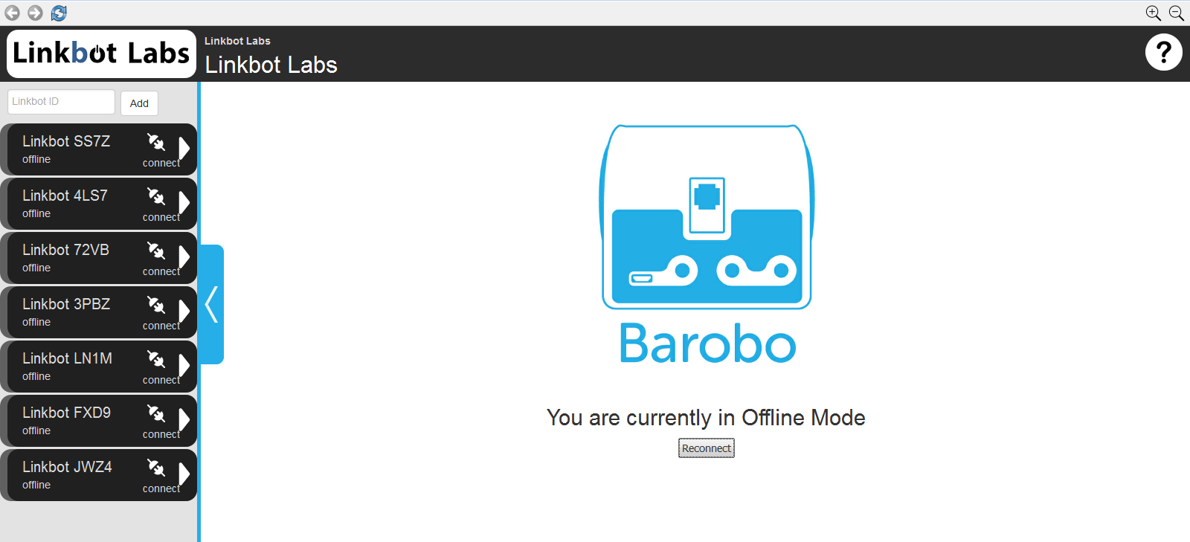
Overview of Linkbot Labs

Slide 13
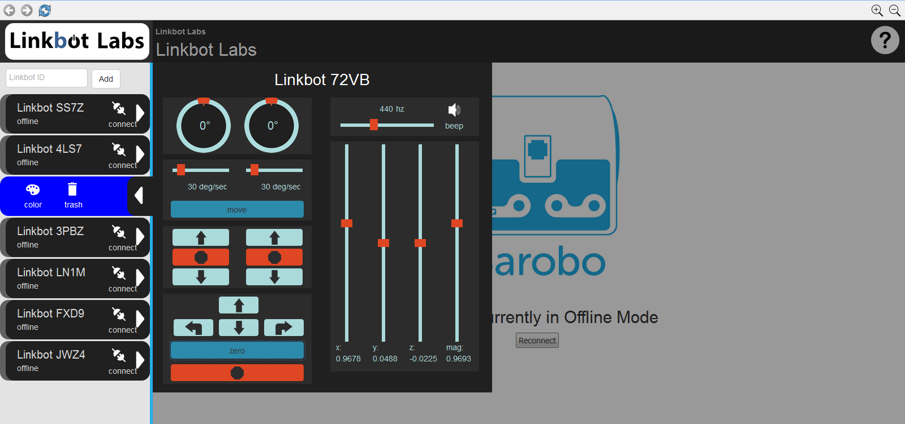
Controlling a Linkbot From Linkbot Labs

Slide 14
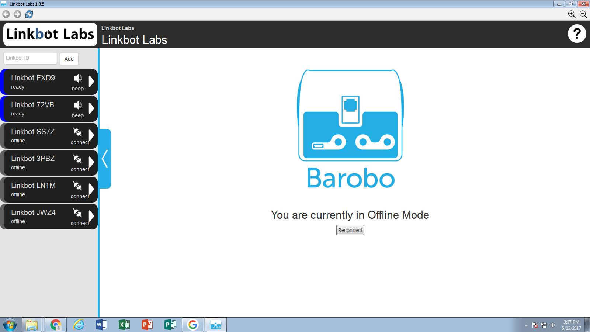
Multiple Linkbots in Linkbot Labs

Slide 15
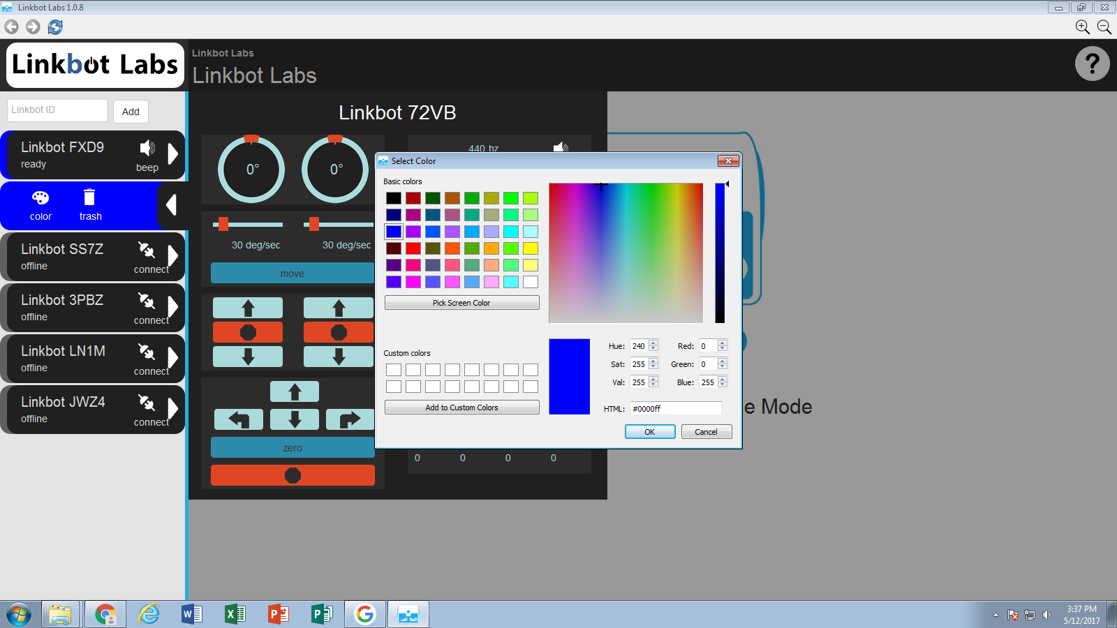
Changing Linkbot Colors
From Linkbot Labs

Slide 16
Connecting Robots Wirelessly
Linkbot Labs in a computer can control one or multiple Linkbots. A dongle or a Linkbot needs to be connected to the computer through the USB cable. For controlling multiple Linkbots, a Linkbot connected to the computer through the USB cable can also act as a dongle for Linkbot Labs to connect and control other Linkbots through the ZigBee wireless communication. The other Linkbots in the network can be located as far as 100 meters.
Multiple Linkbots at the top can also be controlled by a program. You do not even need to connect the Linkbot acting as a dongle to Linkbot Labs so long as it is connected physically through the USB cable.

Slide 17
Connecting a Dongle or Robot

Slide 18
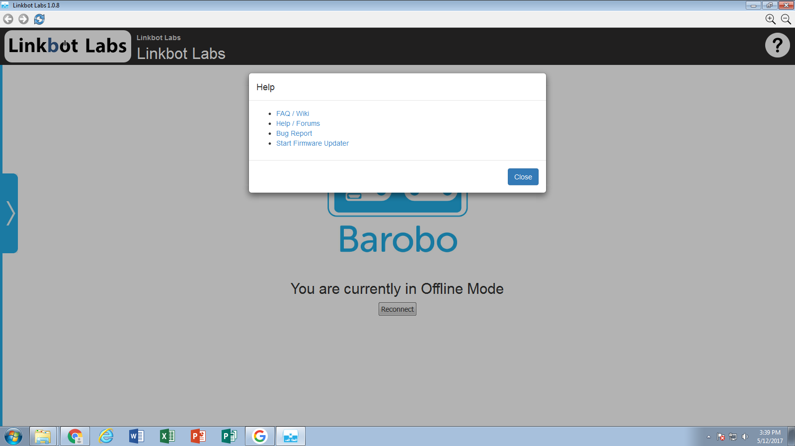
Software Update

Slide 19
How to Code with Linkbots
When coding with Linbots, the first thing you need to write in the file, on line 1, is #include <linkbot.h>. The space between "include" and the < character is optional. There isn't an semicolon after this line. This lets you use the prewritten code in that file, so you don't have to specifically get the robot connected or tell the computer how to move it.
After includeing the Linkbot file, you would need to tell the computer to take the first robot from the list in Linkbot Labs and let you use it. To do so, you would need to write: CLinkbotI robot;. Then you can tell the robot to do things.

Slide 20
A Linkbot-I as a Two Wheel Vehicle
Put wheels and castor
Functions usually start with drive
A Linkbot-I can be configured as a two-wheel robot. In this case, both joints 1 and 3 can rotate together to roll forward or backward.

Slide 21
driveAngle() Function
The function driveAngle() causes both joints 1 and 3 to drive the Linkbot-I forward. The syntax of the function driveAngle() is as follows:
robot.driveAngle(angle);
The amount to roll the wheels forward relative to their current positions is specified by the argument angle. If the value of the argument of the function driveAngle() is negative, it will drive a robot backward.

Slide 22
First Linkbot Program
First, you need to find a Linkbot-I, and put wheels on its joints and a castor on the back. Then, open Linkbot Labs and put its ID in, making sure it is at the top of the list. Open ChIDE, type the code, save it as driveAngle.ch and hit run.
// Drive forward and backward for a Linkbot-I as a two-wheel vehicle
#include <linkbot.h> // calls the necessary file
CLinkbotI robot; // tells the computer to get a Linkbot-I
robot.driveAngle(360); // drive forward by rolling two wheels for 360 degrees
robot.driveAngle(-360); // drive backward by rolling two wheels for 360 degrees

Slide 23
The Explanation
The previous program first drives the Linkbot-I forward 360 degrees for both joints 1 and 3 by robot.driveAngle(360);. Then, it drives the Linkbot-I backward 360 degrees for both joints 1 and 3 by robot.driveAngle(-360); with a negative value −360 for the argument of the function driveAngle().
The prefix drive for a name of a function is reserved for functions to drive a Linkbot-I configured as a two-wheel robot. All functions of the class CLinkbotI for motion including driveAngle() expect input angles in degrees.

Slide 24
Monitor Joint Angles from Linkbot Labs
When a Linkbot program is executed, you can monitor the motion of its joints in the section of the Joint Position Control on the Robot Control Panel in Linkbot Labs. As the Linkbot is moving, the vertical sliders for joints and the joint angles displayed above the sliders will be dynamically updated.
You can run the program driveAngle.ch in Program 3.2 to monitor the joint angles of the Linkbot on the Robot Control Panel in Linkbot Labs. When you run the program, joint 1 will move from 0 to 360 degrees and then back to 0 degree. Joint 3 will move from 0 to −360 degrees, then back to 0 degree.

Slide 25
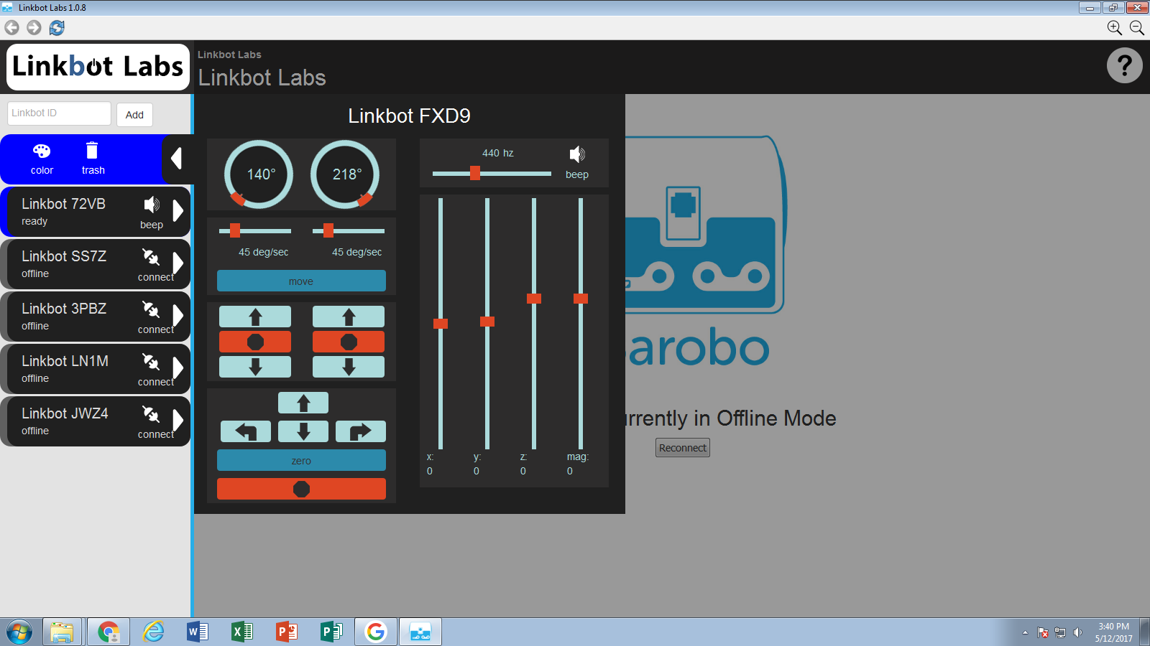
Linkbot Labs Tracking picture

Slide 26
How to Drive a Specific Distance
Like the function driveAngle(), the function driveDistance() causes both motors (joints 1 and 3) to roll the Linkbot-I forward. The syntax is as follows:
robot.driveDistance(distance, radius);
The distance for the Linkbot-I to drive forward is specified by the first argument distance. If the value of the first argument is negative, it will drive a robot backward. The radius of the two wheels attached to the Linkbot, is specified by the second argument radius. The units for both distance and radius must be the same. They can be inches, feet, centimeters, meters, etc.

Slide 27
Turning Left
The CLinkbotI class contains several other functions with useful motions. The function turnLeft() turns a two-wheel toward left with the syntax as follows:
robot.turnLeft(angle, radius, trackwidth);
The angle turned by the robot is specified in the argument angle. The second argument is the radius of the two wheels. The third argument is the track width, the distance between the two wheels (it usually is 3.69). In order to turn the robot the correct angle, the radius of the two wheels and the track width need to be provided and be in the same units.

Slide 28
Turning Right
Similar to the function turnLeft(), the function turnRight() turns a robot toward right with the syntax as follows:
robot.turnRight(angle, radius, trackwidth);
The amount turned by the robot is specified in the argument angle in degrees. The second argument is the radius of the two wheels. The third argument is the track width. The radius and track width need be in the same units.

Slide 29
Sample Turning Program
#include <linkbot.h>
CLinkbotI robot;
double radius = 1.75; // radius of 1.75 inches
double trackwidth = 3.69; // the track width, the distance between two wheels
robot.driveDistance(5, radius);
robot.turnRight(90, radius, trackwidth); // turn right 90 degrees
robot.driveAngle(360);
robot.turnLeft(180, radius, trackwidth); // turn left 180 degrees
robot.driveAngle(360);

Slide 30
Changing the LED Color
Changing the LED color of a linkbot is very simple. All you need to do is write:
robot.setLEDColor("color");
Notice the double quote characters (") around the color. They are necessary. The color changes to the specified color. As an example, to change the color to red, you would write:
robot.setLEDColor("red");

Slide 31
Adding Interactivity into Linkbot Programs
You can make your programs interactive by getting input from the user, such as the distance to drive or angle to turn by using the input and output functions scanf() and printf().
If you have not seen the first presentation and have never heard of scanf() or printf(), go to that presentation here and learn about it before continuing.

Slide 32
Example Interactive Program
#include <linkbot.h>
CLinkbotI robot;
double distance, angle; // declare variables distance to drive and angle to turn
double radius = 1.75; // radius of the wheels in inches
double trackwidth = 3.69; // track width in inches
printf("Enter the distance to drive and angle to turn\n");
scanf("%lf%lf", &distance, &angle); // User inputs distance in inches and angle
robot.driveDistance(distance, radius);
robot.turnRight(angle, radius, trackwidth);

Slide 33
More Information
For more information you can look online at drive.google.com/file/d/0BzUQxmg82CwkWW11NXU5cGtJVXc/view.
You also can email or talk to Simon. v

